Slide 1
Reading is great!

Slide 2
Reading
is to the mind
what exercise
is to the body
Richard Steele

Slide 3
I like books
I really do.
Books with stories
And pictures, too.

Slide 4
Books of birds
And things that grow.
Books of people
We should know.

Slide 5
Books of animals
And places, too.
I like books
I really do!

Slide 6
adventure
stories
detectives
Kinds of books
fairy-tales
poems
comics
fantasy

Slide 7
Welcome
to the library

Slide 8
My favourite book

Slide 9
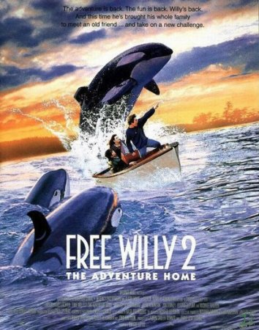

Slide 10
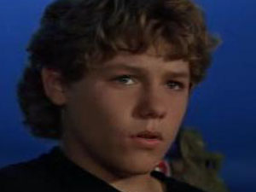
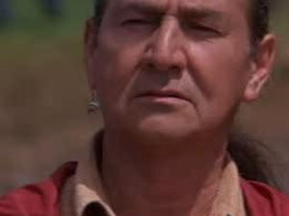
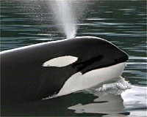

Slide 11
The title is…
The writer is…
The book is about…
The main character is…
He/She is…
I like this book because…
I recommend it to people
who like…
Plan:

Slide 12
Let’s do exercises
for your eyes

Slide 13
Golden rules:
books with Treat care as friends
good
Treat books with care
as good friends

Slide 14
Golden rules:
turn Do not a page
the chapter
down
to mark
Do not
turn down a page
to mark the chapter

Slide 15
Golden rules:
mark
a book Use
Use a book mark

Slide 16
I recommend you
to read:

Slide 17
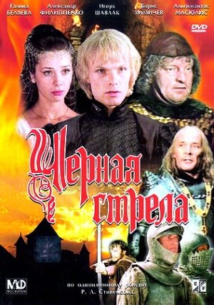
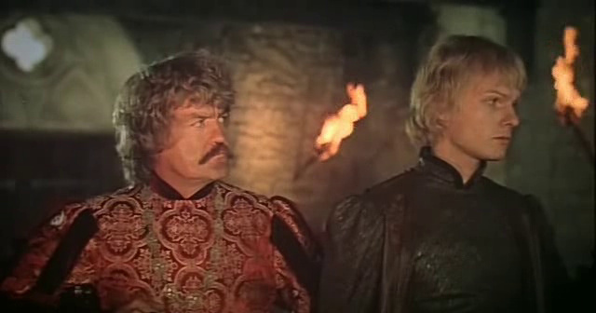
“The black arrow”
by R.Stivenson

Slide 18
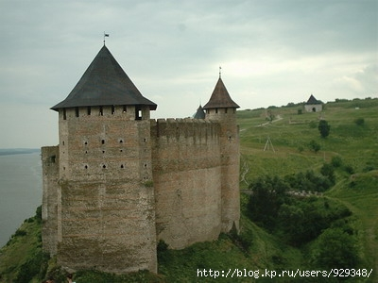
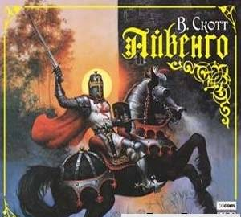
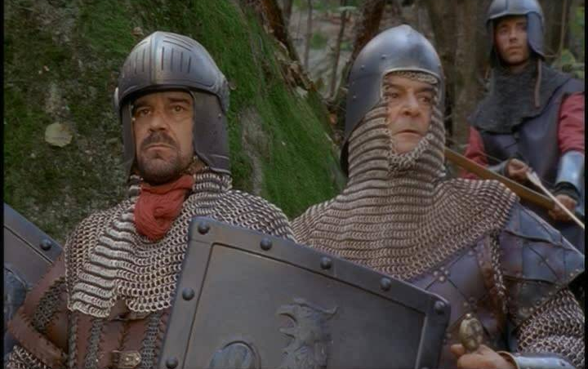
“Ivanhoe”
by W.Scott

Slide 19
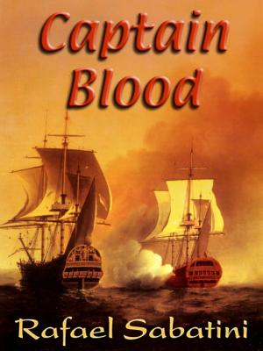
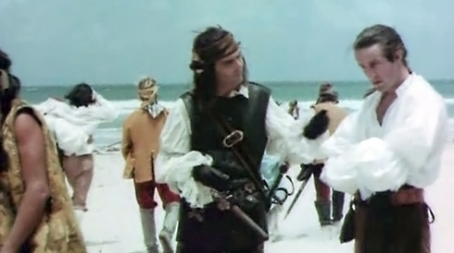

Slide 20
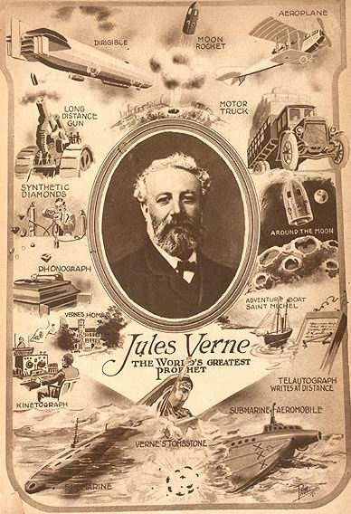
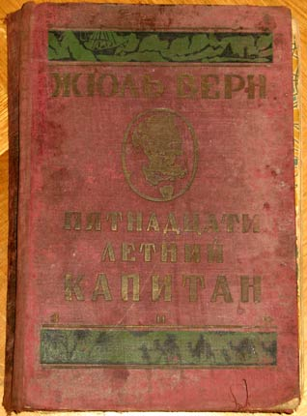
Books by J. Verne

Slide 21
Reading is great, isn’t it?

Slide 22
Proverbs:
Books are our best friends
You can’t judge a book
by its cover
Choose an author
as you choose a friend

Slide 23
Your Home Work:
Projects
Dialogues

Slide 24
Good-bye

